Slide 1

Information Visualization
Sai Nishanth Mettu

Slide 2
Formula One Race Data Visualization
01.

Slide 3
DATA SOURCE & DIMENSIONS
Preprocessed Dataset | Size in Approximation
WinsPoles.csv circuits.csv | >1200 rows
constructor_results.csv constructor_standings.csv | >4000 rows
constructors.csv currPointSystem.csv | ~100 rows
drivers.csv driver_standings.csv | >2000 rows
lap_times.csv pit_stops.csv qualifying.csv | >4000 rows
races.csv results.csv | >4000 rows
seasons.csv status.csv worldChampions.csv | ~300 rows
1. Kaggle (https://www.kaggle.com/rohanrao/formula-1-world-championship-1950-2020)
2. Web Scraping (https://motorsportstats.com/series/formula-one/records/2021)
3. http://ergast.com/mrd/
4. https://www.kaggle.com/datasets/cjgdev/formula-1-race-data-19502017

Slide 4
TOOLS USED
Pre-processing – Azure ML Designer, Python Libraries.
Visualizations – Altair, Seaborn, Tableau (Trial Version), Matplotlib, Plotly
Editing Tools for the Poster – Canva Online
Today, that trailblazing spirit makes NYU one of the most prominent and respected research universities in the world, featuring top-ranked academic programs and accepting fewer than one-in-five undergraduates.

Slide 5
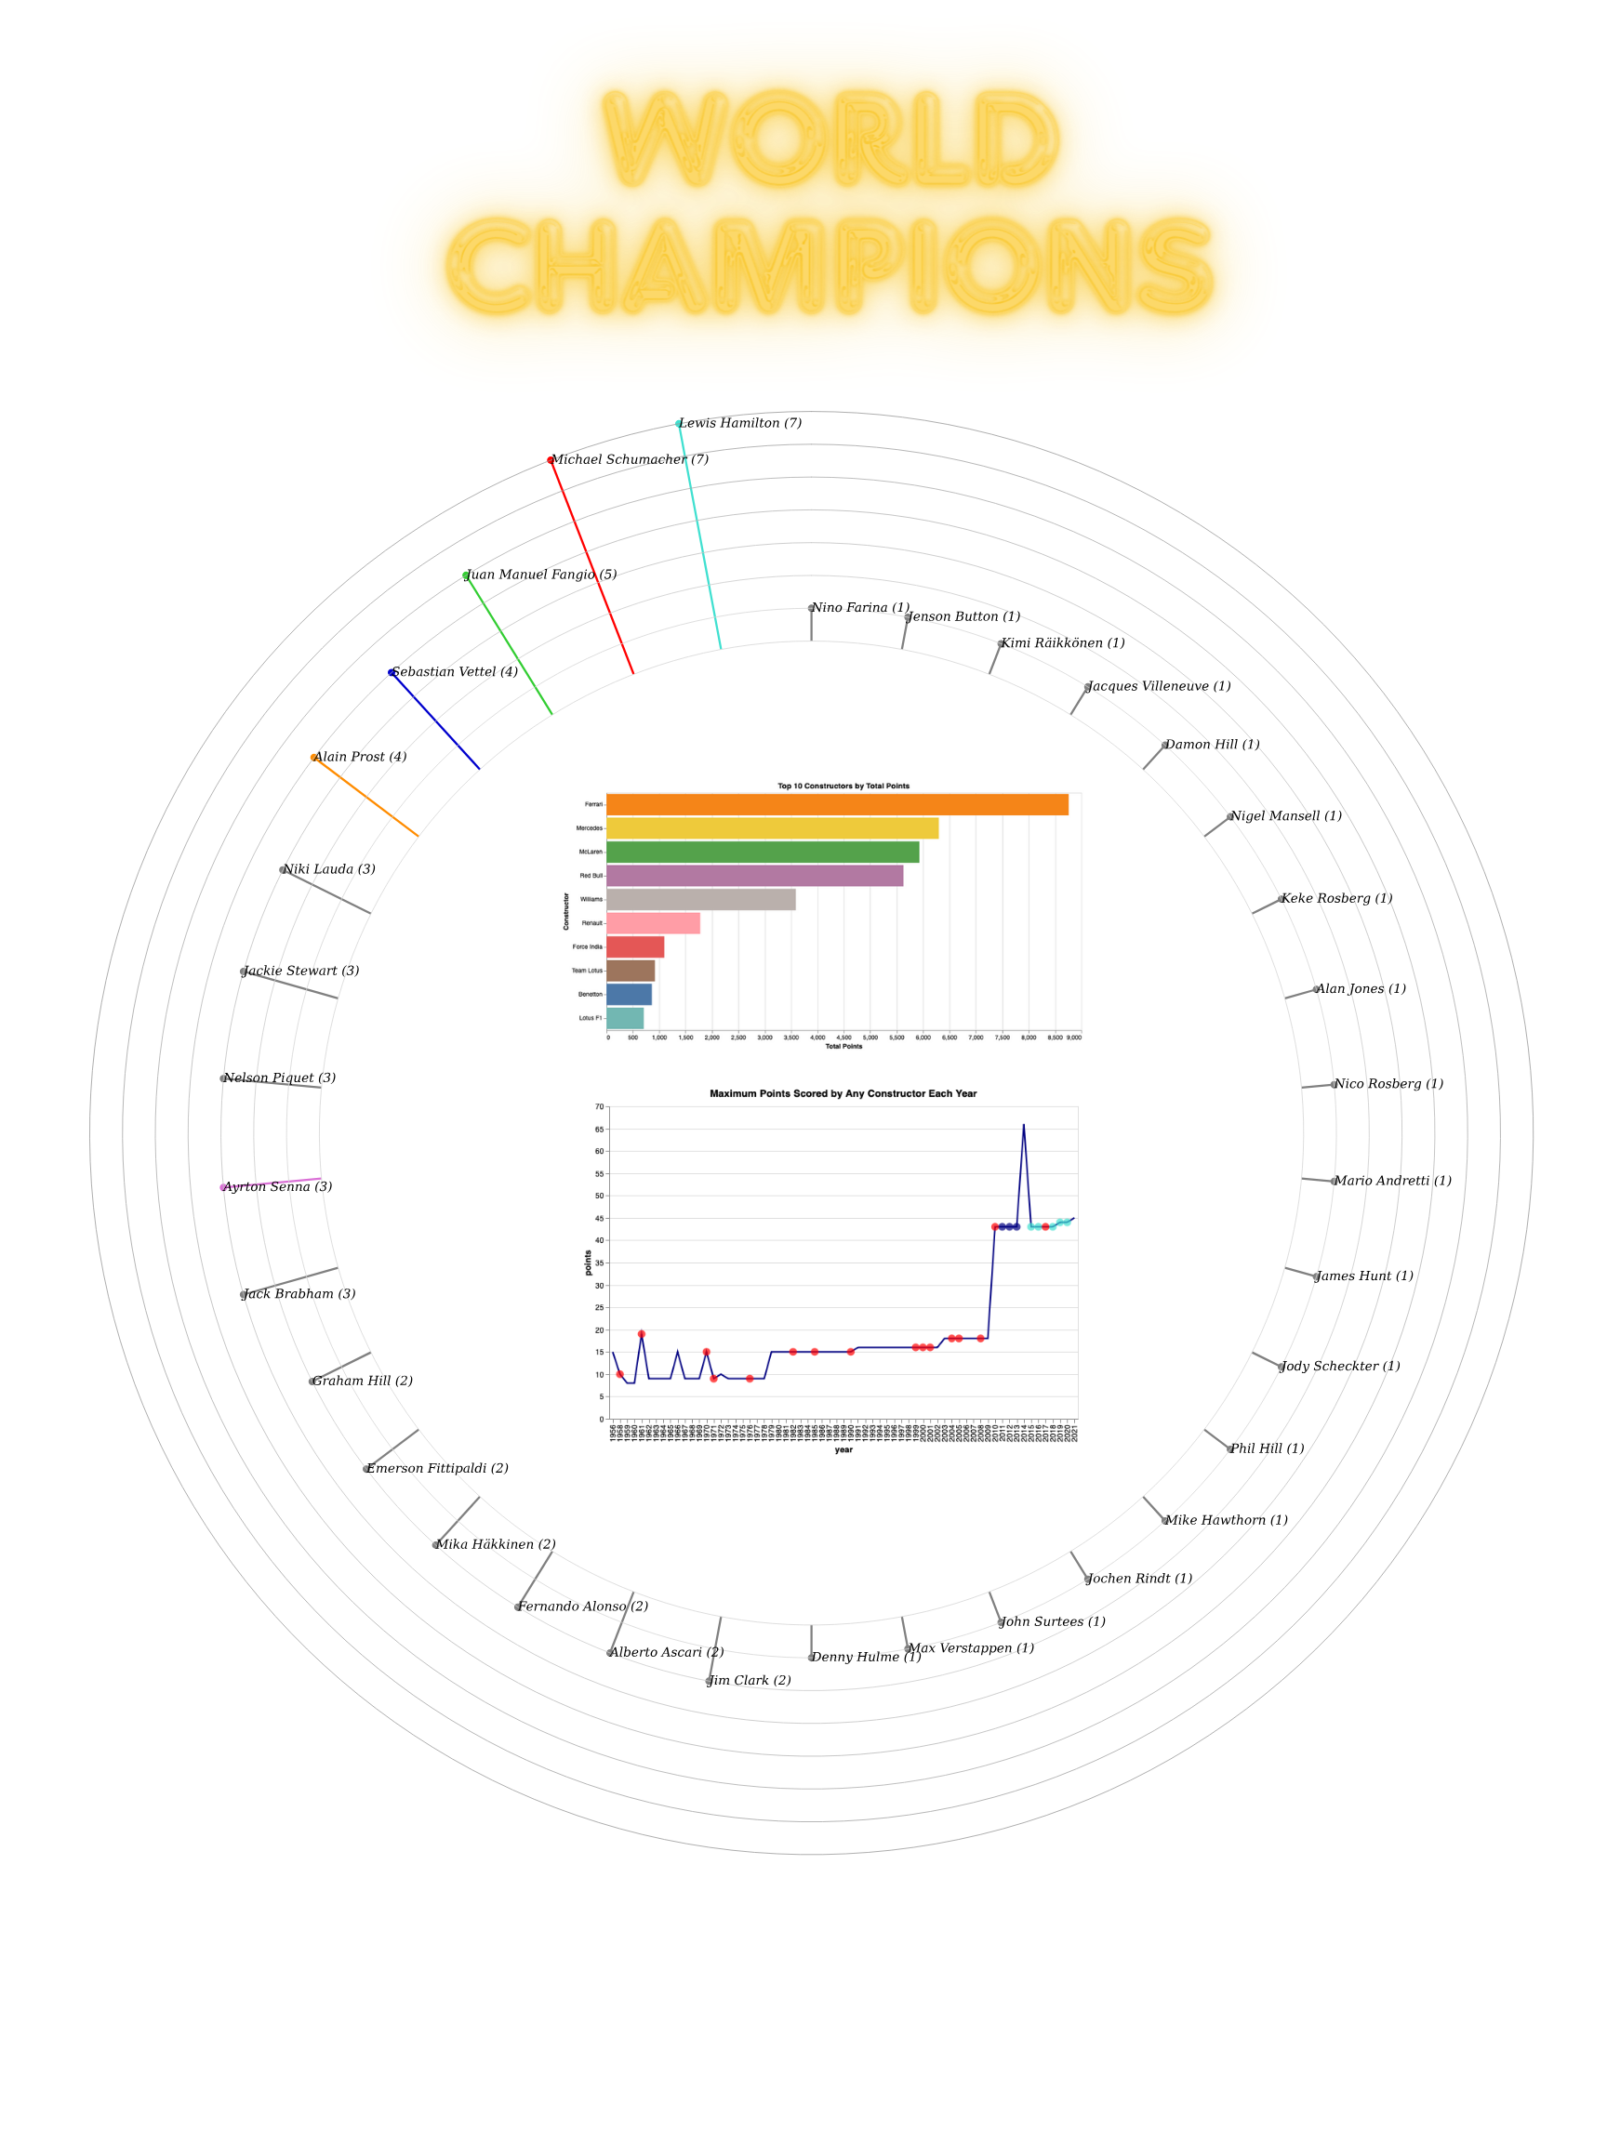
Poster Chart 1:
Figuring out the Dominant Drivers
Combined Plot : Radial & Lollipop Plot, with a bar and line graph internally.
Visual Encoding : Each Lollipop is size-encoded, and each ring represents number of championships. Top 5 Drivers have a color encoding based on their respective team.
Inference : By using this, we can infer which team and driver is the most dominant in the history of F1
Tools Used : Altair & Seaborn

Slide 6
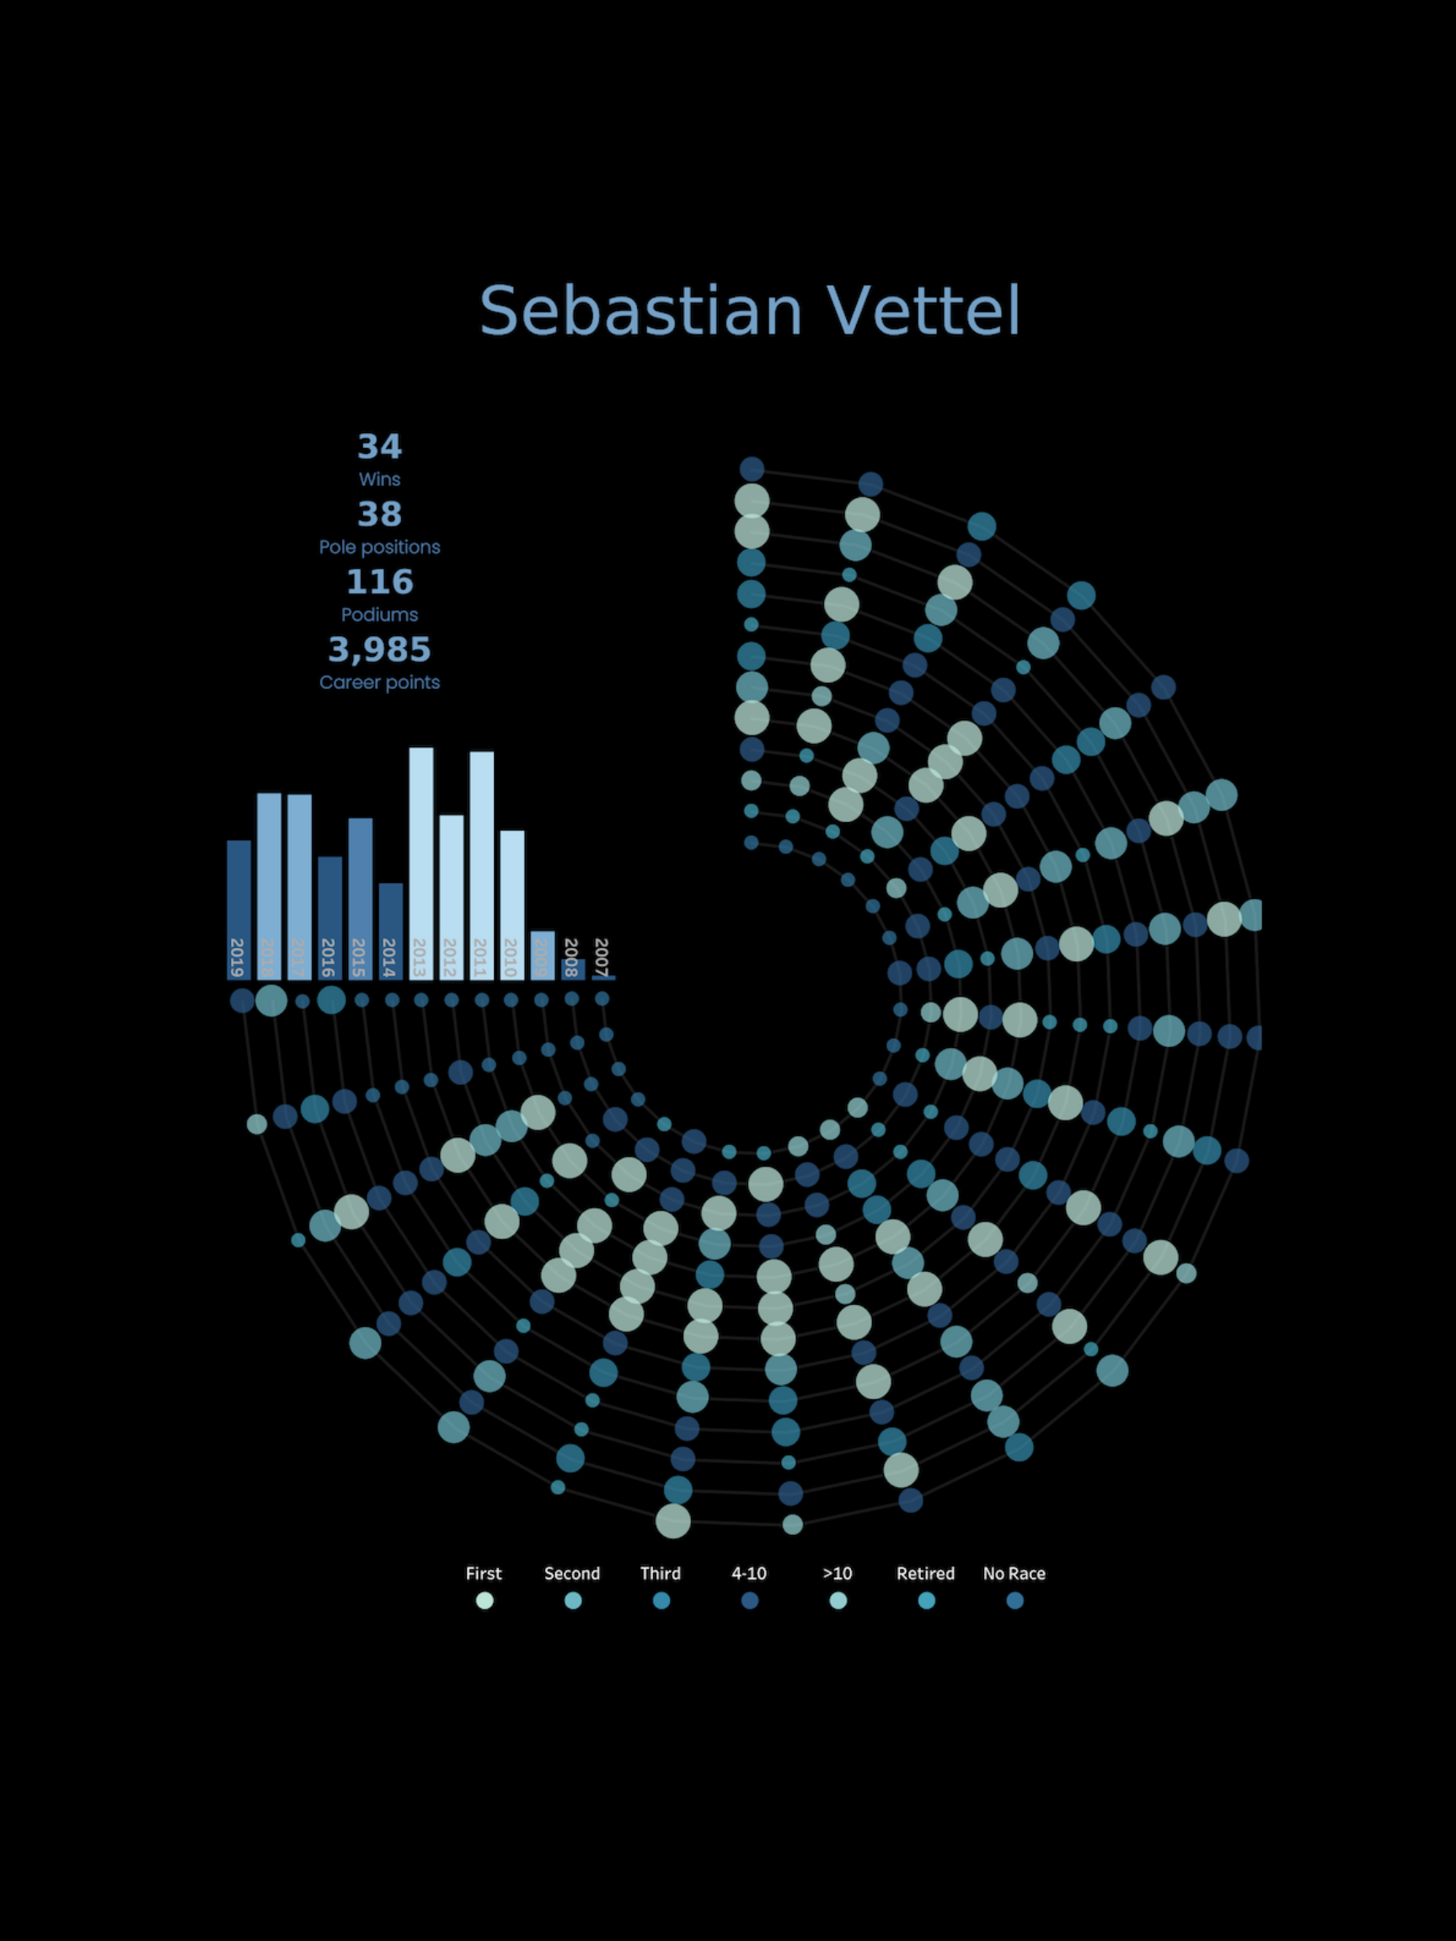
Poster Chart 2:
Comparing the Careers of Champions
Combined Plot : Radial & Bar Plot
Visual Encoding : Each Radial Line represents a year, and each dot represents the result in a race that year with a size and color encoding. The bar graph at the end depicts the points scored in aggregate over the year.
Inference : By using this plot, we can infer how a single driver fared over a single year.
Tools Used : Azure ML Designer for Preprocessing, Tableau, Altair, Canva
Tableau Radial Plot Reference : https://www.youtube.com/watch?v=d6-aptKLvgg

Slide 7
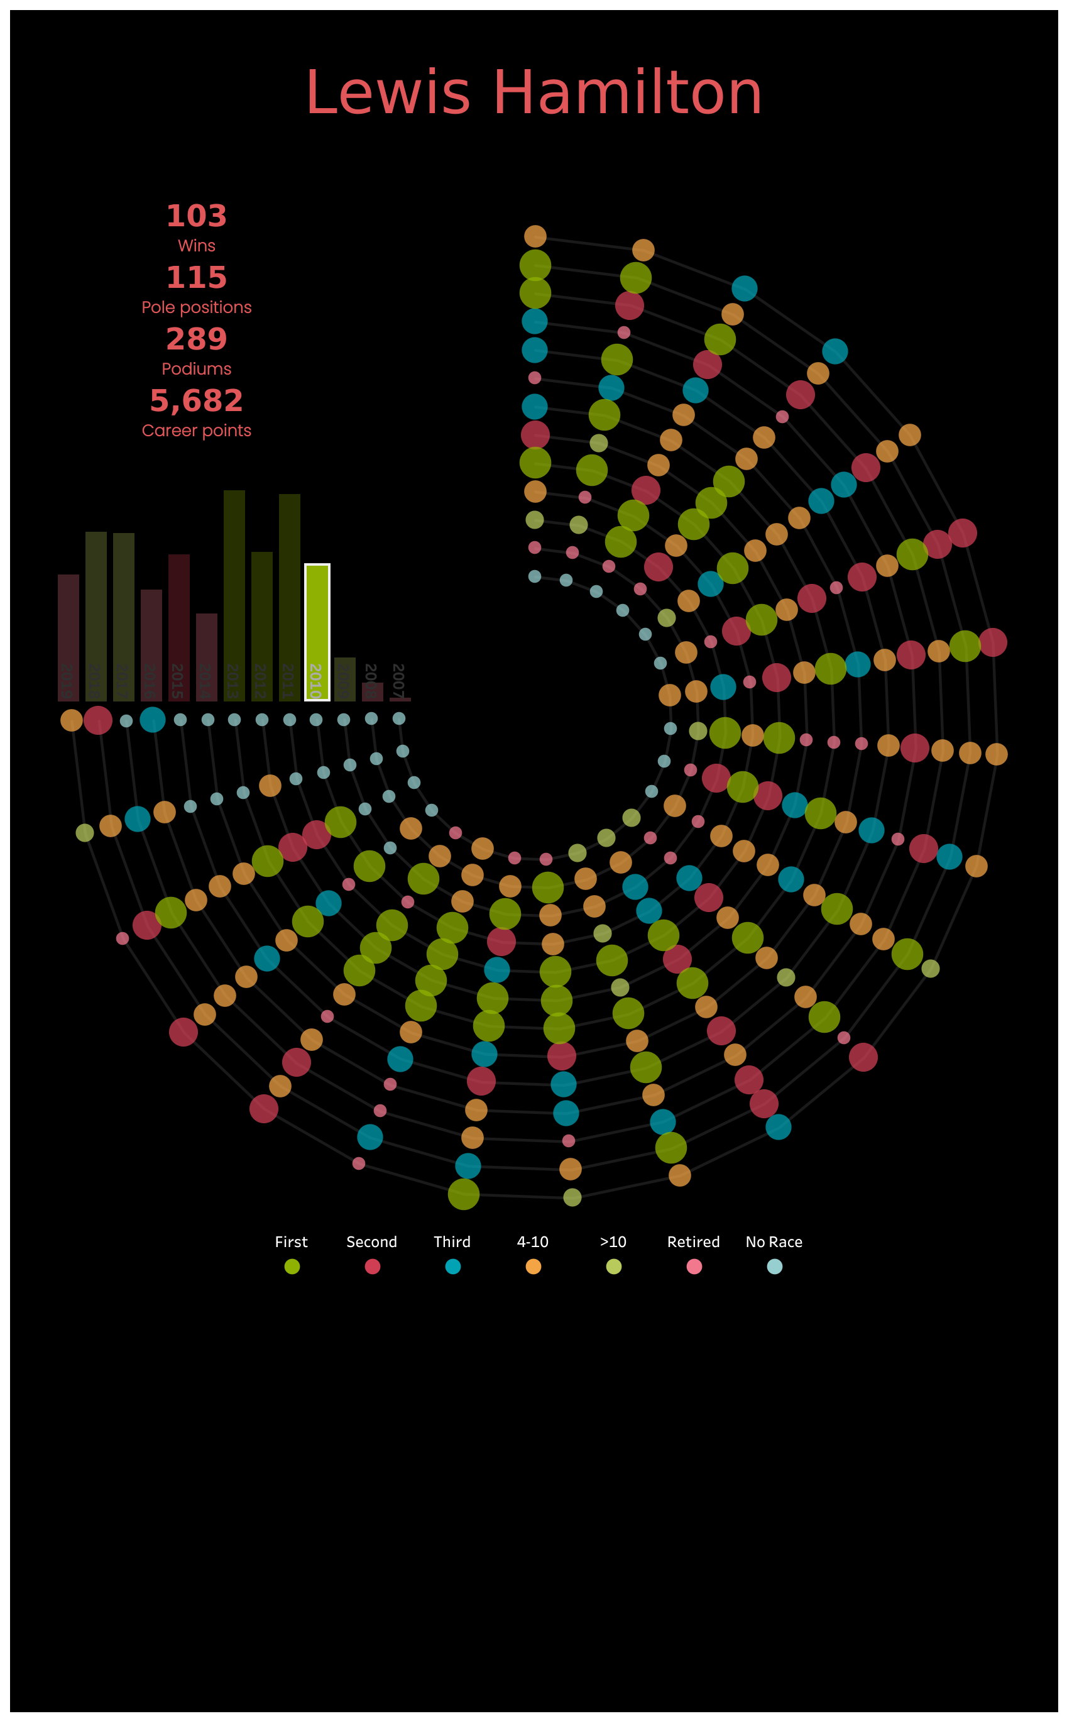
Poster Chart 3:
CONTINUED…

Slide 8
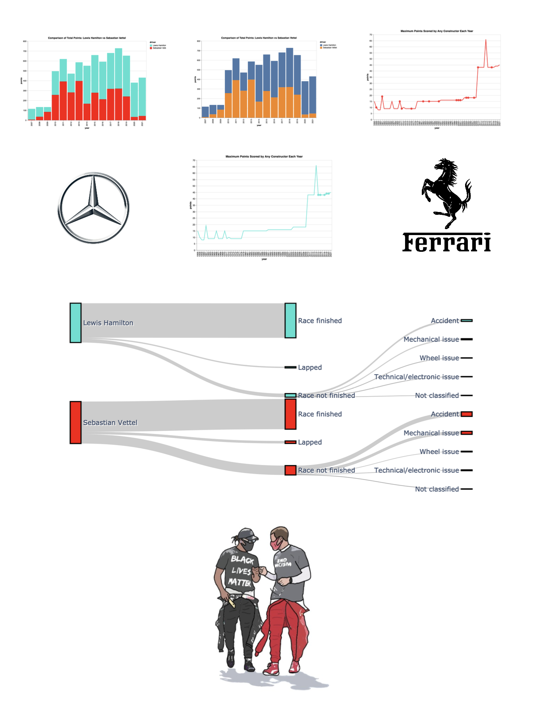
Poster Chart 4:
Comparing the Careers of Champions
Combined Plot : Sankey Plot
Visual Encoding : Fluid Flow Encoding which represents the percentage of races finished under different circumstances. Color encoding of “Turquoise and Red” to determine the teams.
Inference : By using this plot, we can easily interpret how Tools Used : Seaborn, Altair, Azure ML Designer(pre-processing)
Tableau Radial Plot Reference : https://www.youtube.com/watch?v=d6-aptKLvgg

Slide 9
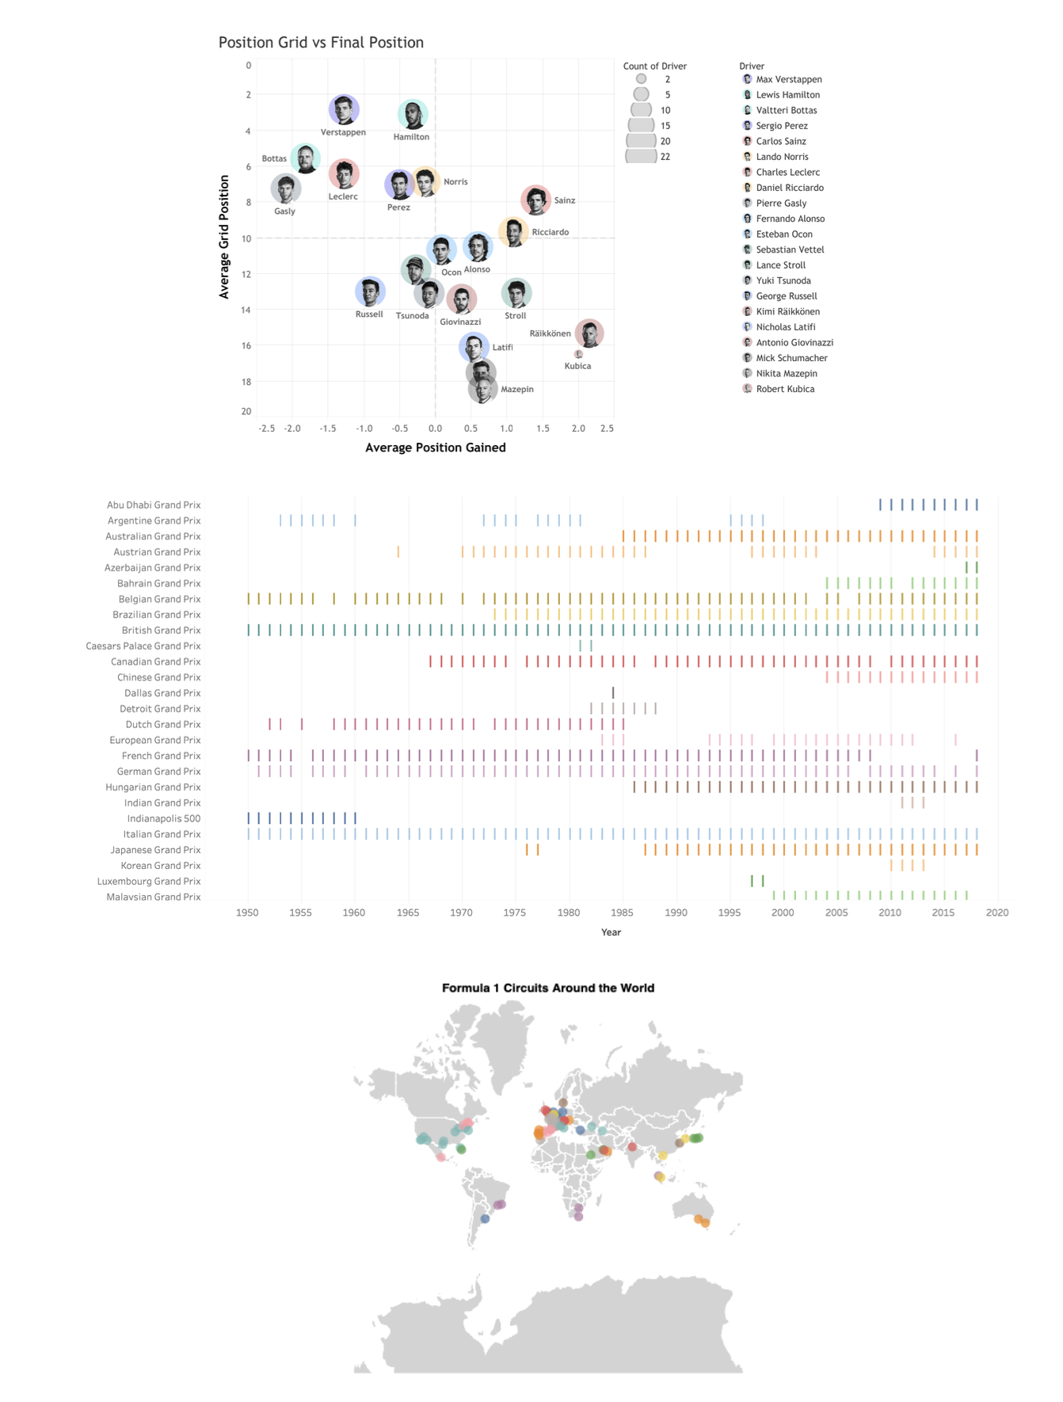
Poster Chart 5:
Combined Plot : Pictorial Grid Plot, Map Plot & Dash Plot
Visual Encoding : Each Dot represents the other drivers start and end positions in F1. Each Dash Represents the Circuit’s participation and each colored dot represents where the circuit is. Each Circuit and Location has a different color encoding
Inference : By using this plot, we can visually understand where the race circuit is and the frequency of a race at a circuit
Tools Used : Pics-Art for Drivers Pictures, Altair, Seaborn

Slide 10
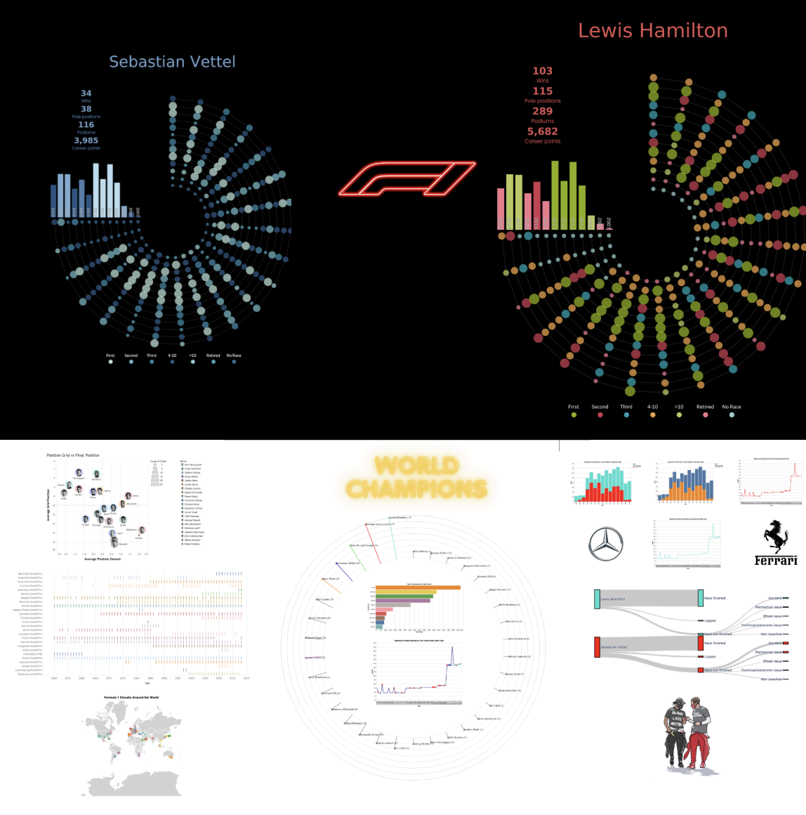
PRINTABLE
POSTER…

Slide 11
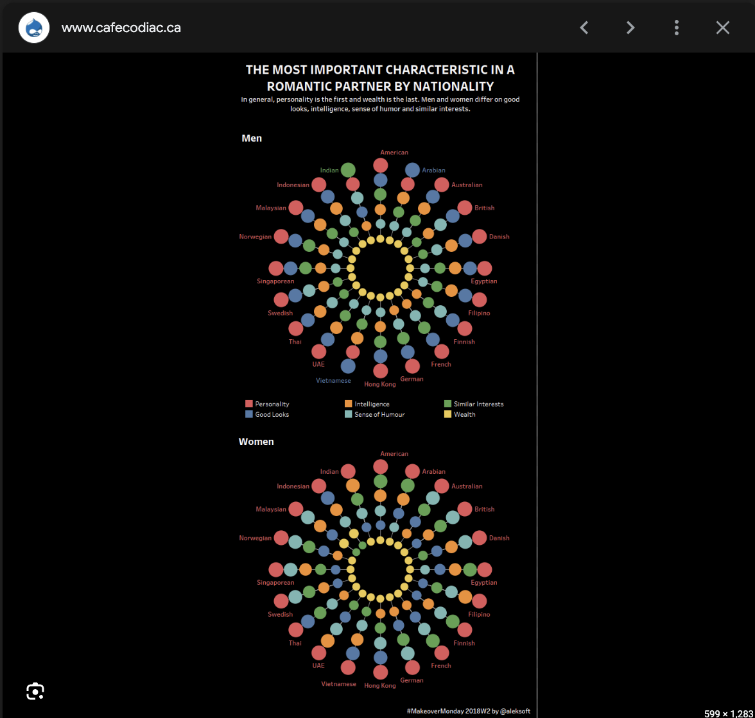
References & Ideas
https://www.flerlagetwins.com/2019/02/whos-afraid-of-big-bad-radial-bar-chart_21.html
https://in.pinterest.com/pin/782852347722323825/
https://www.thedataschool.com.au/jethro-chen/the-radial-bar-chart-in-tableau-tutorial/
https://rocheap.bedandbreakfaststamford.org/category?name=radial%20bar%20chart%20tableau

Slide 12
Thank you Sai Nishanth Mettu

